Slide 1

INFORMATION SYSTEM FOR BUSINESS INTELLIGENCE USING APRIORI MODULE
P. ASUWINI
R.KAVITHA
FRANCIS XAVIER ENGINEERING COLLEGE

Slide 2

OVERVIEW:
Problem statement
Introduction
Proposed model
Techniques
Components
Formula
Application
Results
Conclusion

Slide 3
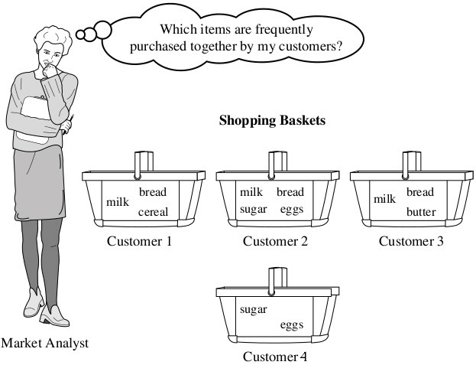
Problem Statement:
To find frequently purchased item set from large transactional database by using Apriori module in IBM SPSS Modeler.

Slide 4
INTRODUCTION:
Data science
Data science is a multidisciplinary blend of data inference, algorithm development, and technology in order to solve analytically complex
Data analytics
Data analytics refers to qualitative and quantitative techniques and processes used to enhance productivity and business gain.
Data analytics is also known as data analysis.

Slide 5
Business Intelligence
The term Business Intelligence (BI) refers to technologies, applications and practices for the collection, integration, analysis, and presentation of business information.
Predictive analytics
Predictive analytics is a category of data analytics aimed at making predictions about future outcomes based on historical data and analytics techniques such as statistical modeling and machine learning

Slide 6
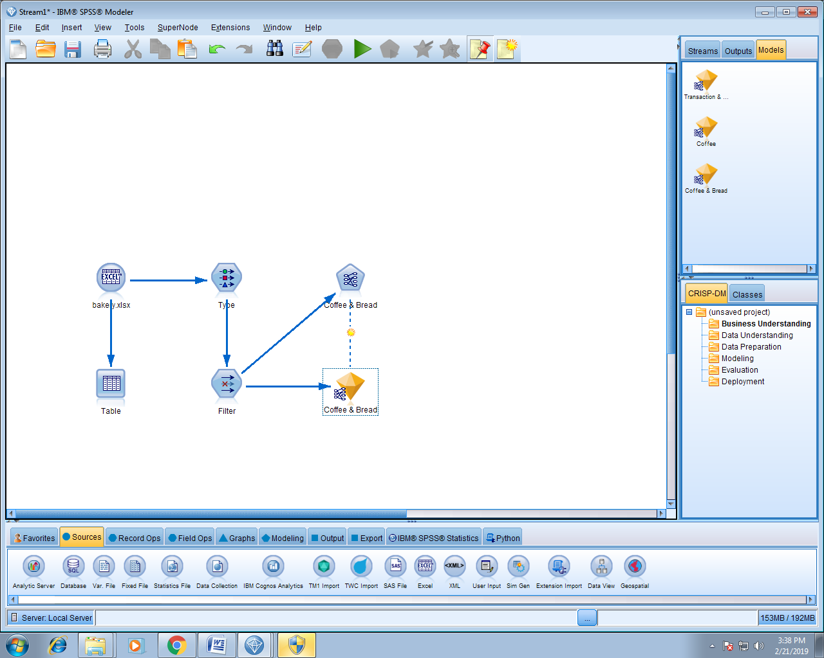
Proposed Model

Slide 7
Source node is used to insert the data
Table node is used to display the data
Type node is for defining the data for each and every attributes of the data sets
Apriori includes many techniques for modeling and analyzing several variables, when the focus is on the relationship or association between specific values in large datasets

Slide 8
Techniques:
APRIORI ALGORITHM
All subsets of a frequent itemset must be frequent. If a itemset is infrequent all its supersets will be infrequent.

Slide 9
Apriori is an algorithm for frequent item set mining and association rule learning over transactional databases.
It proceeds by identifying the frequent individual items in the database and extending them to larger item sets.
The frequent item sets determined by Apriori can be used to determine association rules which highlight general trends in the database

Slide 10
COMPONENTS:
Two significant components comprise the apriori algorithm. They are as follows.
1. Support
2. Confidence

Slide 11
Formula:
No. of Transaction containing A & B
Support(A->B)= ________________________
Total no. of Transaction
No. of Transaction containing A & B
Confidence(A->B)= ________________________
No. of Transaction containing A

Slide 12
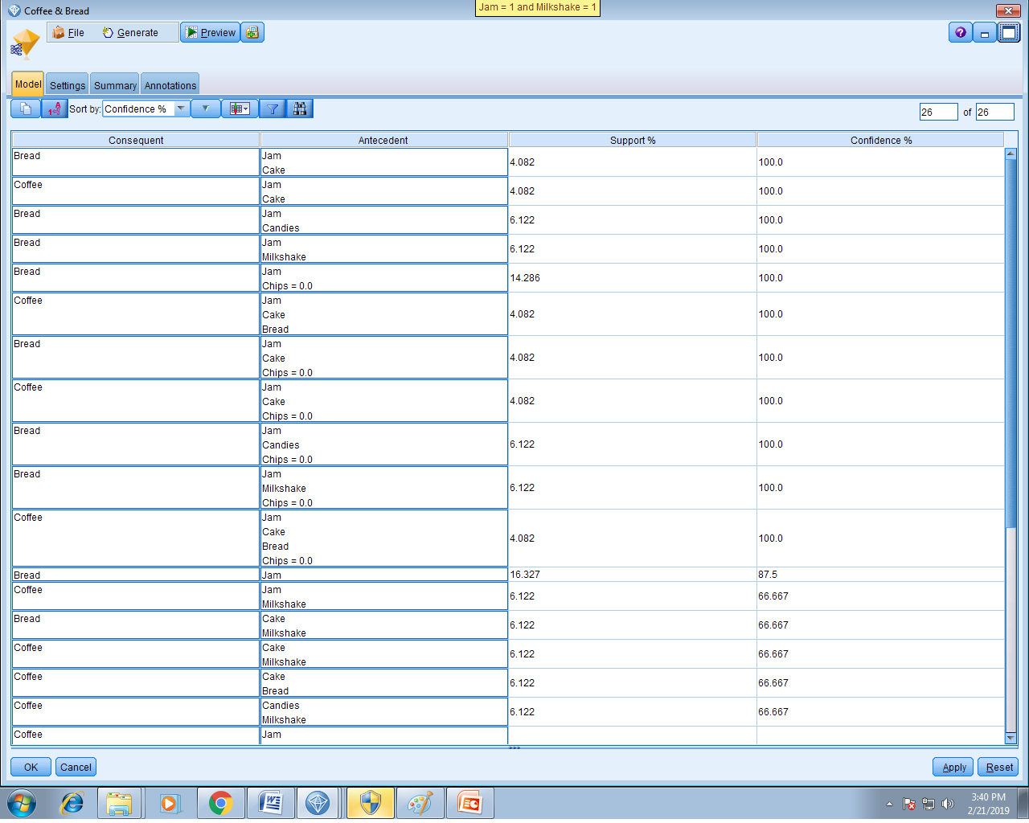
RESULT:

Slide 13
CONCLUSION:
With the help of predictive analysis, using IBM SPSS Modeler we can conclude the frequent set of items among the large transactional database by using apriori algorithm. By the help of data analytics, we can provide the business solution for improving their commercial activities and run succesfully.

Slide 14
APPLICATION:
1. Market Basket Analysis
2. Telecommunications
3. Credit Cards/ Banking Services
4. Medical Treatments
5. Basket Ball – Game Analysis

Slide 15
ADVANTAGES:
1. Uses large item set property
2. Easy to implement
DISADVANTAGES:
1. Requires many database scans
2. Assumes transaction database is memory resident.

Slide 16
THANK YOU

